Slide 1
ethylene dimerization: development of anti-fouling agents
Sibo Lin¹, Motaz Khawaji², Mohamed Elanany², Wei Xu²
13th International conference on Catalysis, Chemical Engineering and Technology
October 21, 2022

Slide 2
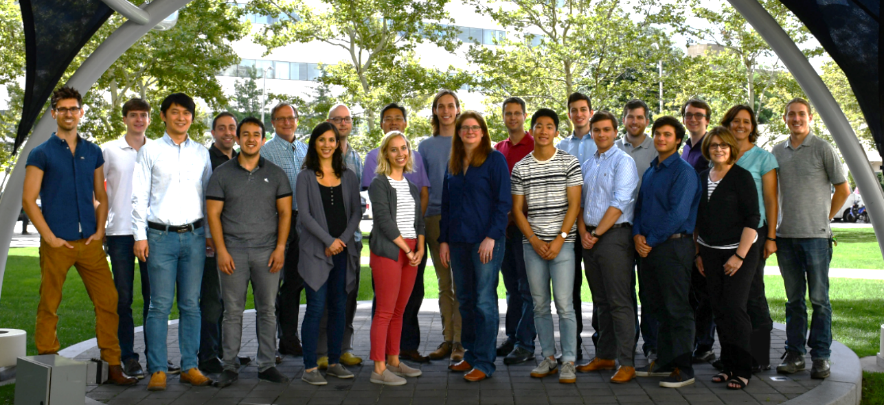
acknowledgements
Aramco Americas
Advanced Materials Team (Cambridge, MA)
Jenna C. Fromer
Yagnaseni Ghosh
Brian Hanna
Douglas Theberge
Dana A. Wong
Atieh Abu Raqabah
Saudi Aramco Chemicals R&D
Mohamed Elanany
Wei Xu
Motaz Khawaji
King Fahd Univ. of Petroleum and Minerals
E. A. Jaseer
Samir Barman

Slide 3


boston downstream research center
mission: accelerate downstream innovations through development and optimization of advanced materials

Slide 4
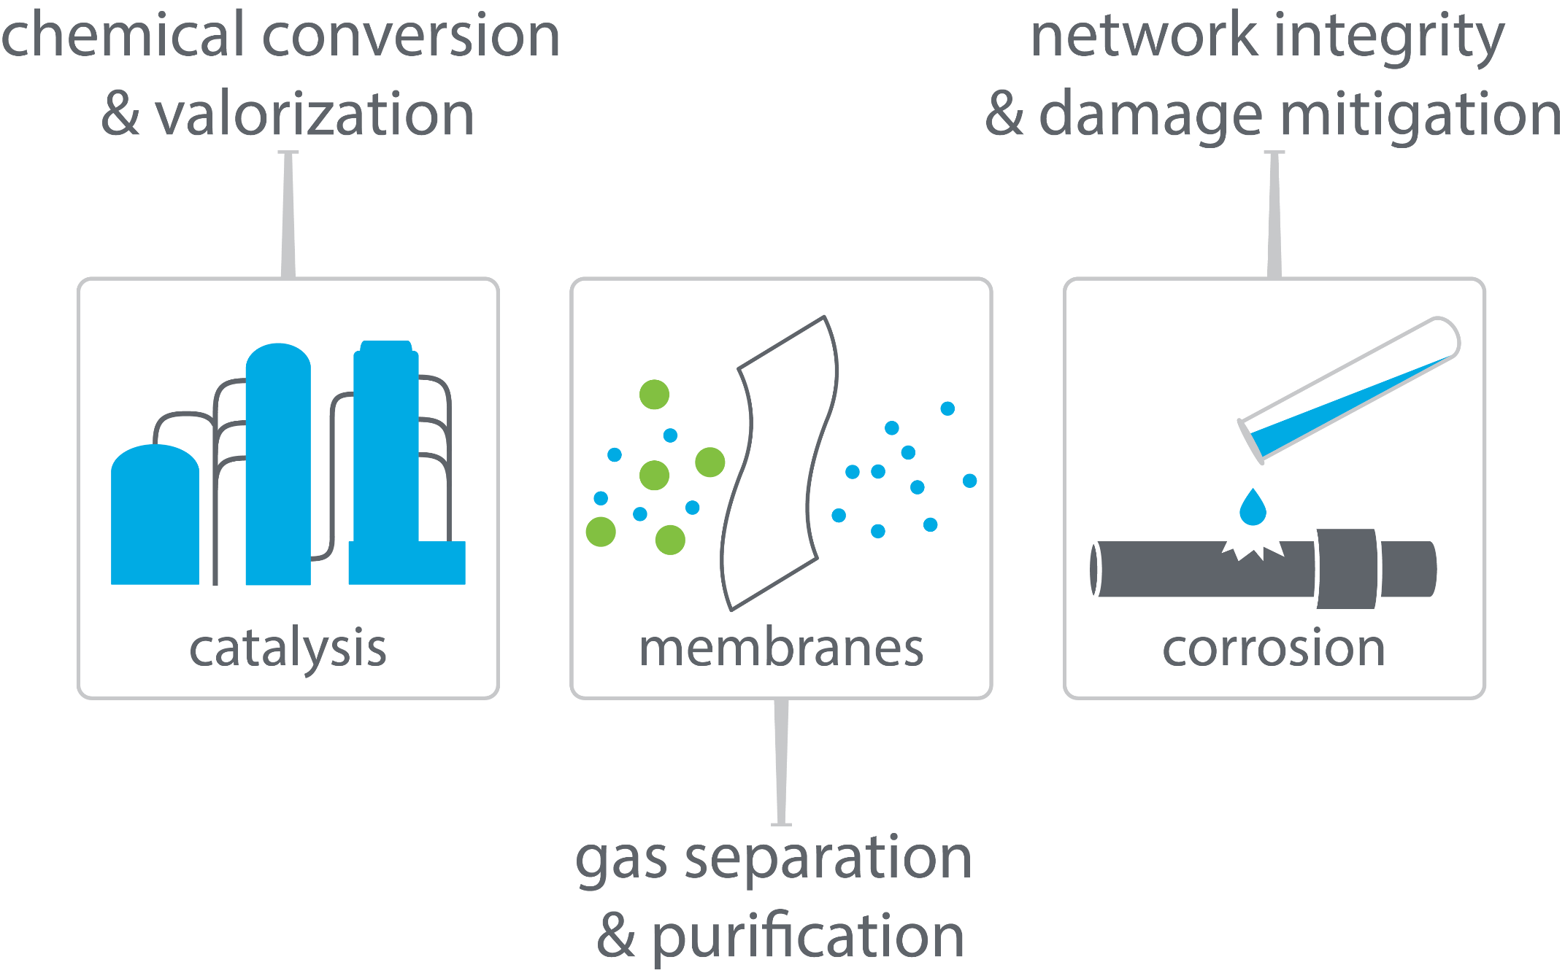
boston downstream research center

Slide 5
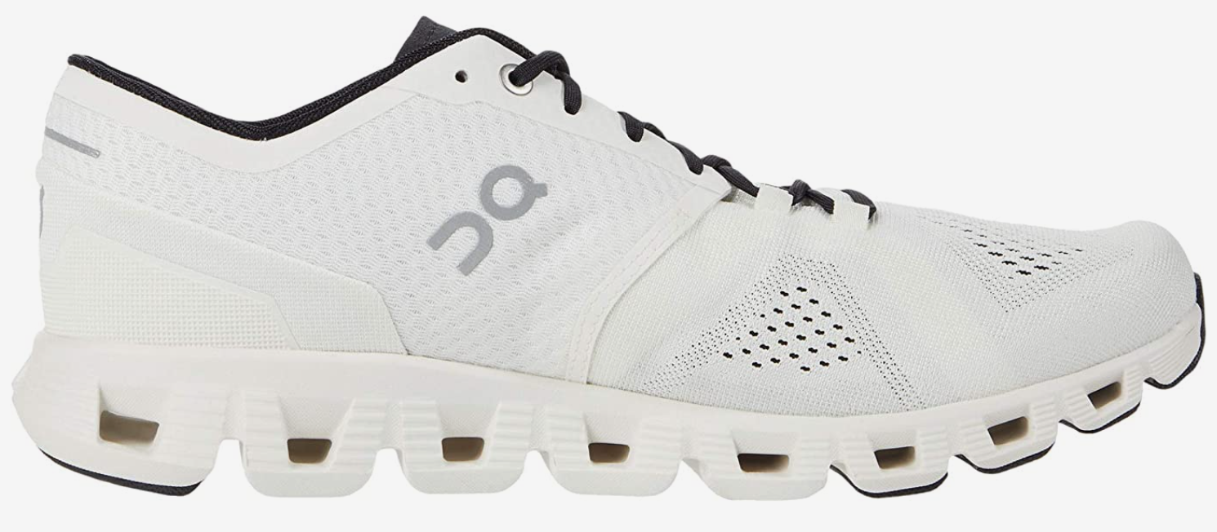
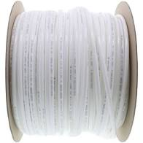

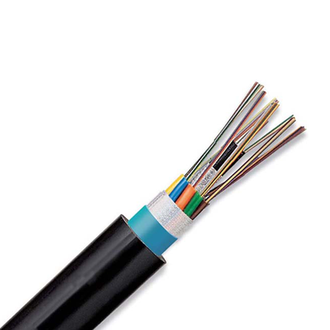
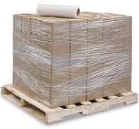
1-butene for LLDPE
tough
flexible and food-safe
polyethylene plant
LLDPE
ethylene
stretchable
electrical and chemical safety
1-butene
polymer processibilty and ductility improve

Slide 6
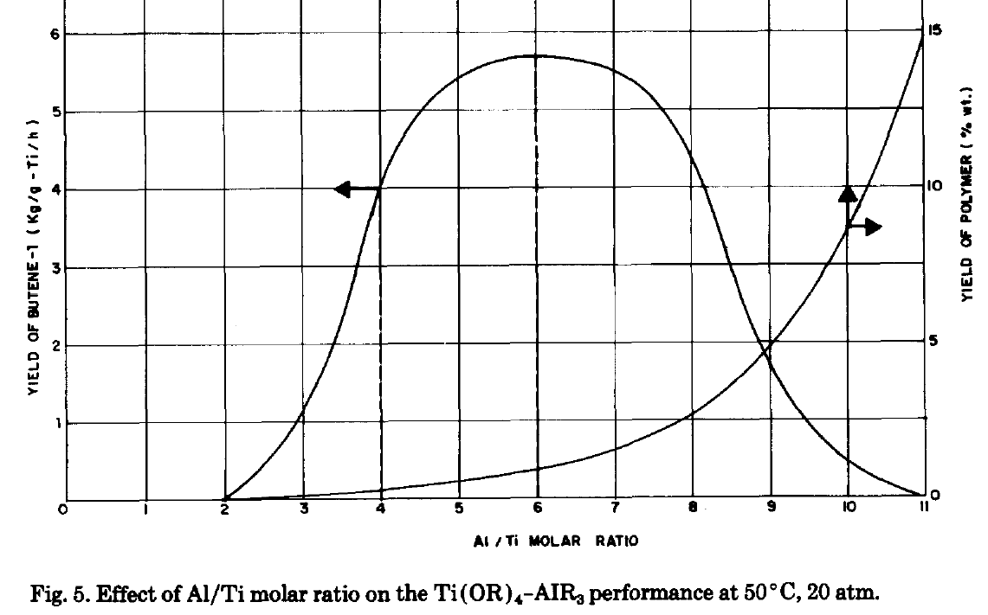
selective ethylene dimerization (and unavoidable polymerization)
reactor unit fouling
Depending on Al/Ti ratio, various species:
Al/Ti < 2: Ti(IV) only
Al/Ti > 2: Ti(III) observed
Al/Ti > 10: Ti(II) observed
1-butene (kg / g-Ti / h)
polymer (wt%)
Can molecular modelling reveal mechanisms for 1-butene and polyethylene formation?
Can additives be developed to suppress PE?
Al / Ti molar ratio
Al-Sa’doun A. W., Appl. Catal. A, 1993, 105, 1
Confidential

Slide 7
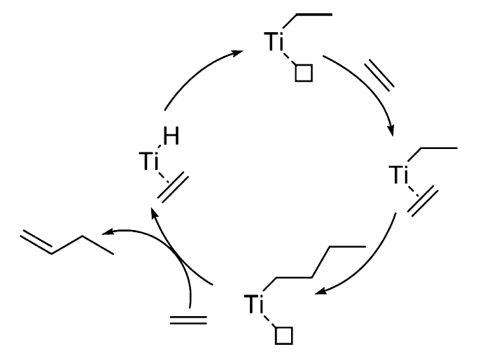
ethylene dimerization by Ti(III)
McGuinness’s 2013 model incorrectly predicts C6+ selectivity instead of 1-C4 selectivity
Ehm’s 2014 benchmarking study on Ti/Al Ziegler Natta species²
inclusion of dispersion corrections is critical for energetic accuracy
M06 functional is less accurate than B3LYP-D3 functional
Applying Ehm’s methods to Alphabutol mechanism, correct 1-C4 selectivity is predicted!
¹ McGuinness and coworkers, ACS Catalysis, 2013, 3, 3006.
² Ehm and coworkers, J. Organomet. Chem. 2014, 772, 161.
³ This work: B3LYP-D3/def2-TZVP // B3LYP-D3/def2-SVP
Confidential

Slide 8
comparing Ti(IV) vs Ti(III)
polymerization
catalyst
Can anionic additive selectively poison Ti(IV) species?
Can multidentate alcohols selectively inhibit chain growth while allowing chain termination?
1-butene
catalyst

Slide 9
Ti(IV) vs Ti(III): bromide-binding
Bromide binds preferentially to Ti(IV) species,
poisoning polymerization catalysts.
If more bromide than Ti(IV) is used, then Ti(III) sites can be poisoned too.

Slide 10
anionic anti-fouling compounds (AFCs)
Anionic additive lowers polyethylene byproduct and overall 1-butene activity
Can multidentate alcohols inhibit Ti^{IV} polymerization AND increase overall 1-butene activity?
Patent: WO 2016/205194 A1
Ti(OBu)₄:THF:AlEt₃:AFC = 1:6:7.5:0.3
¹ g-ethylene / mmol-Ti / h
Notes:
AFA cation important for solubility in hydrocarbon solvent, but does not interact with cationic catalyst
Catalytic activity does not increase—sometimes decreases—with anionic additives

Slide 11
oligo(ethylene glycol) (OEG) multidentate alcohols
Various possible OEG binding modes
General OEG structure
Can multidentate alcohols inhibit Ti^{IV} polymerization AND increase overall 1-butene activity?
Semi-automated conformational search: XTBDFT
Lin, S.; Elanany, M.; Khawaji, M. SoftwareX 2022, accepted
(preprint: https://ssrn.com/abstract=4155262 )
Lin, S.; Fromer, J. C.; Ghosh, Y.; Hanna, B.; Elanany, M.; Xu, W. Sci. Rep. 2021, 11, 4534.

Slide 12
OEG prefers to bind to Ti(IV) over Ti(III)
OEG binds preferentially to Ti(IV) instead of Ti(III)

Slide 13
OEG will switch Ti(IV) from polymerization to dimerization
polymerization
catalyst
Ti (IV) + OEG
1-butene
catalyst

Slide 14
Excess OEG will switch Ti(III) from dimerization to polymerization
1-butene
catalyst
Ti (III) + OEG
polymerization
catalyst

Slide 15
OEG additives: lower PE AND higher activity
Multidentate alcohols (OEG) inhibit Ti^{IV} polymerization AND can increase overall 1-butene activity
Patent: US 2017/0197892 A1
¹ g-ethylene / mmol-Ti / h

Slide 16
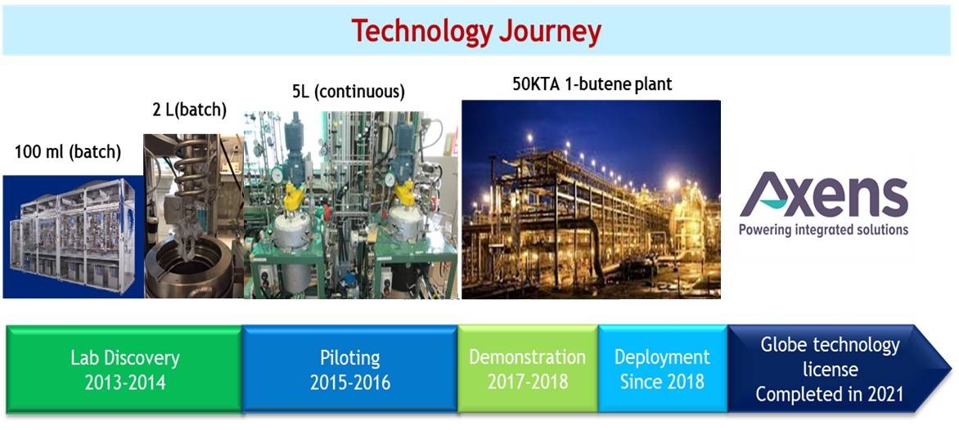
Summary and Deployment
Ti(III) is butene-selective, Ti(IV) is PE-selective
Anionic additives can poison Ti(IV) catalyst, and reduce PE
Multidentate alcohols can bind to Ti(IV) and flip catalyst selectivity to 1-butene

Slide 18
backup slides

Slide 19
Ti(IV) vs Ti(III)
polymerization
catalyst
1-butene
catalyst
1-butene
catalyst
polymerization
catalyst

Slide 20
correcting for ethylene pressure
DFT energies assume STP for all reagents, but high reagent/Ti ratio means that reagent coordination is enhanced and must be corrected for (Baik and coworkers, Organometallics 2018, 37, 3228)
mole fraction ethylene in hexane at 50 C, 2.3 MPa = 0.25 (source: Motaz) → [ethylene] ~ 1.9 M
[Ti] = 0.001 M
G_{corr} = RT*ln([ethylene]/[Ti]) = 5.298 kcal/mol

Slide 21
beta-hydride transfer (inner- vs outer-sphere transition states)
outer-sphere BHT
(proposed for Alphabutol:
McGuinness and coworkers, ACS Catalysis, 2013, 3, 3006 )
inner-sphere BHT
(proposed for other transition metals:
Ess and coworkers, Dalton Trans., 2020, 49, 7747)
conventional BHE

Slide 22
Computational Method (XTBDFT)
XTB
GFN2-xTB and CREST
DFT (NWChem)
Adapted from Ehm, C.; Antinucci, G.; Budzelaar, P. H. M.; Busico, V. J. Organomet. Chem. 2014, 772, 161. (In order of decreasing accuracy: M06-2X > B3LYP-D3 > M06)
Geometry optimization and frequency calculations: B3LYP-D3/def2-SVP
Single-point energy: B3LYP-D2/def2-TZVP

Slide 23

Ti(III) simulations
Re-evaluate key stationary points from McGuinness’s study on Ti(III) polymerization catalysts
Our computational method ( )predicts chain termination barrier is -2.6 kcal/mol vs chain growth!
6.2
-1.0
-10.5
ΔG (kcal/mol)
-12.5
L₂Ti-Et
-23.0
L₂Ti-Bu
-23.0
M06/(def2-QZVP,SDD-Ti and 6-311+G**)//B3LYP-noD/(SSD-Ti and 6-31G(d))
B3LYP-D3/def2-TZVP//B3LYP-D3/def2-SVP
M06/def2-QZVPP,SDD-Ti and 6-311++G**)//B3LYP-D3/def2-SVP

